Slide 1

BCDE222 ChessMaze GAME PLAYER <<Model>>
Assessment 2 Semester 2 2023
Julan Ray Avila Gutierrez

Slide 2
Contents
Sections:
MOSCOW Features (MUST-HAVES)
Class Diagrams
Features (Implementation)
Testing
Expected Marks

Slide 3
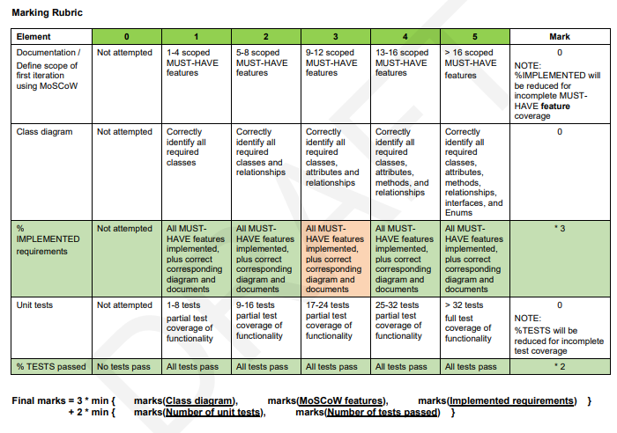
Expected Marks

Slide 4
MOSCOW Features (Must-Haves)

Slide 5
1. Must have a game board with correct co-ordinates
2. Must have movement for Rook
3. Must have movement for King
4. Must have movement for Queen
5. Must have movement for Knight
6. Must have movement for Bishop
7. Must be able to detect incorrect movement
8. Must have the ability to select pieces to move
9. Must not accept movement to empty squares
10. Must count total number of moves
11. Must highlight current selected piece
12. Must have a reset button
13. Must have an undo button
14. Must have a timer
15. Must show time taken to beat level
16. Must acknowledge level completion
17. Must display level name

Slide 6
Class Diagrams

Slide 7
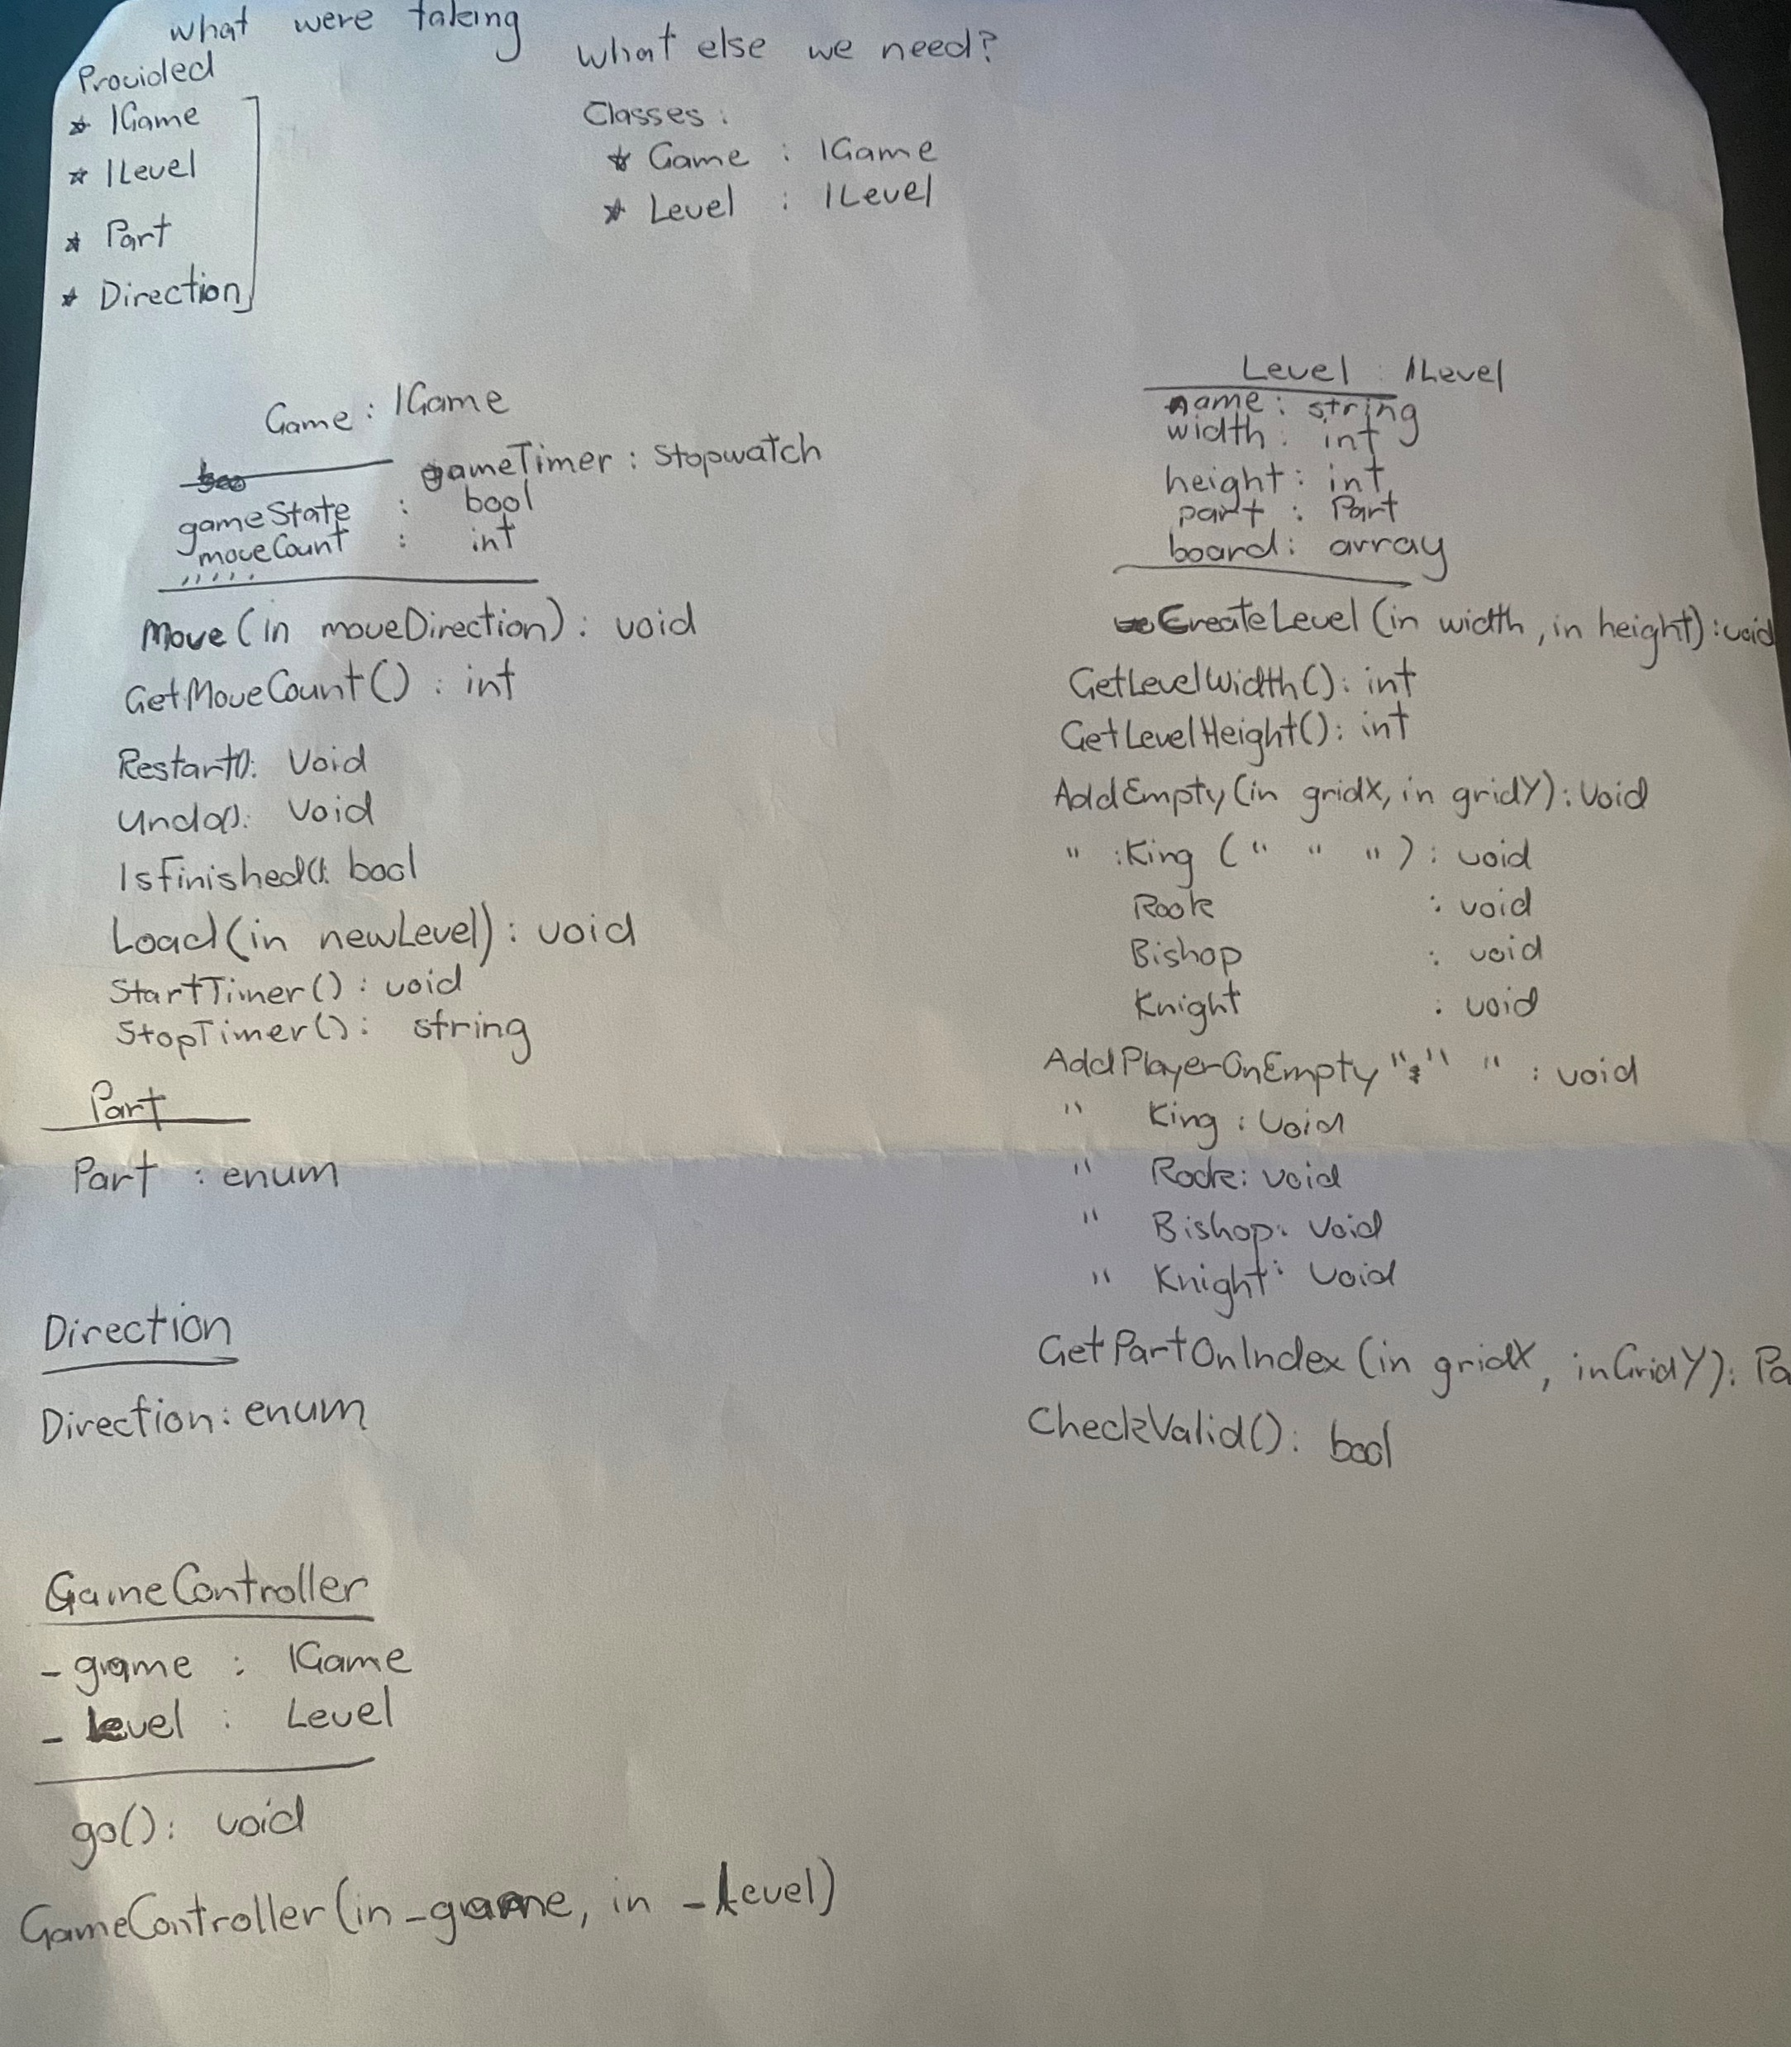
Conceptual Diagram
First Iteration used for initial build Solution.

Slide 8
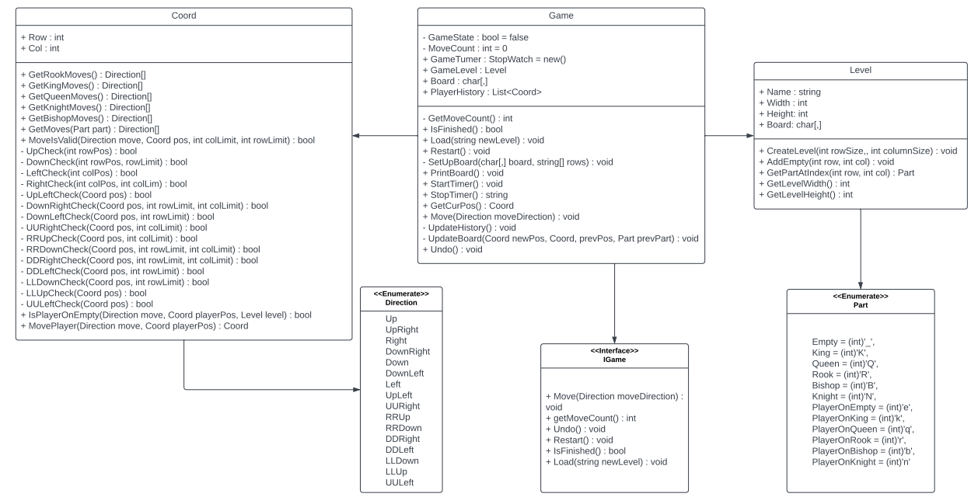
Game Player <<Model>> UML Class Diagram
Final Build Class Diagram

Slide 9
Features (Implementation)

Slide 10
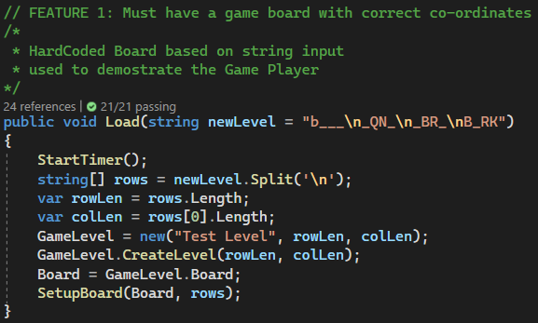
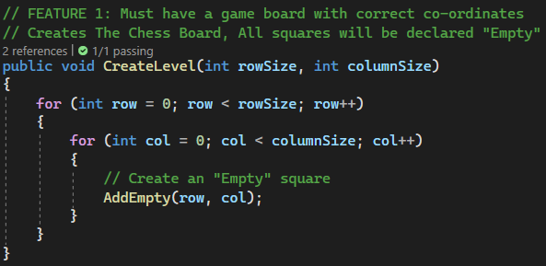
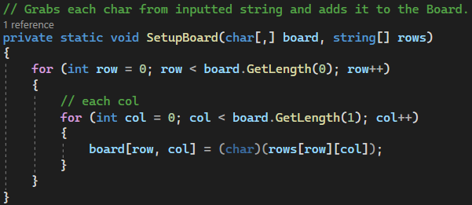
1. Must have a game board with correct co-ordinates
Level Initialization. Hard Coded to demonstrate the Game Player Functionality.

Slide 11
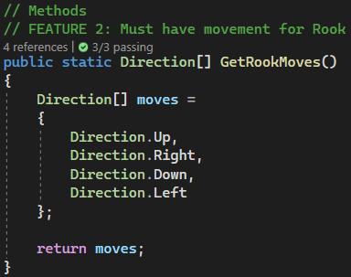
2. Must have movement for Rook
Returns an array Move Set for the Rook

Slide 12
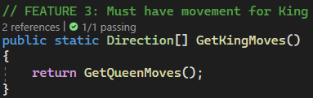
3. Must have movement for King
Returns an array Move Set for the King
Note: Inherits Queen moves as they have the same move set.

Slide 13
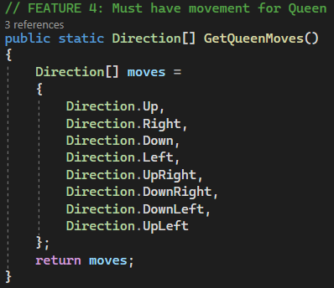
4. Must have movement for Queen
Returns an array Move Set for the Queen

Slide 14
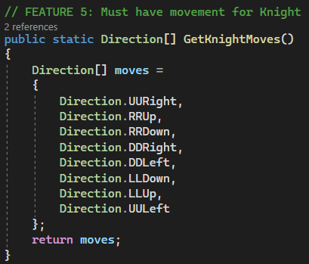
5. Must have movement for Knight
Returns an array Move Set for the Knight

Slide 15
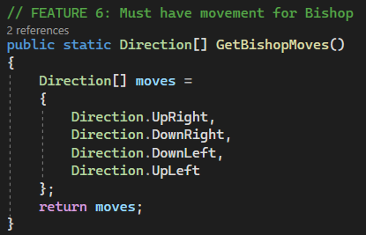
6. Must have movement for Bishop
Returns an array Move Set for the Bishop

Slide 16
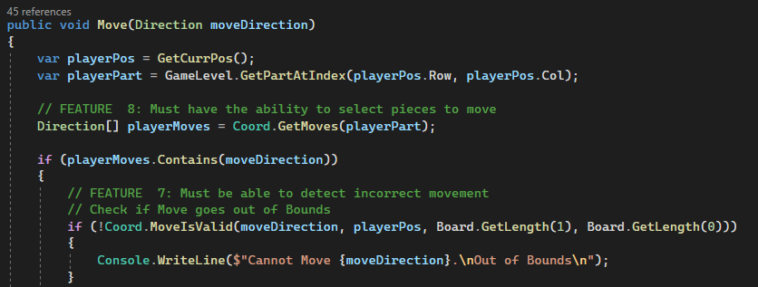
7. Must be able to detect incorrect movement
Checks if the move is within bounds of the Level’s Board.

Slide 17
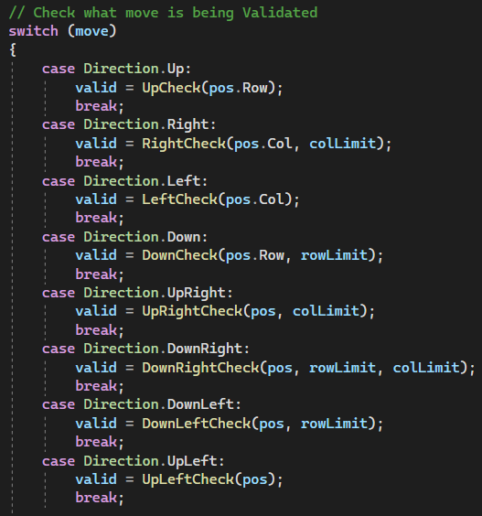
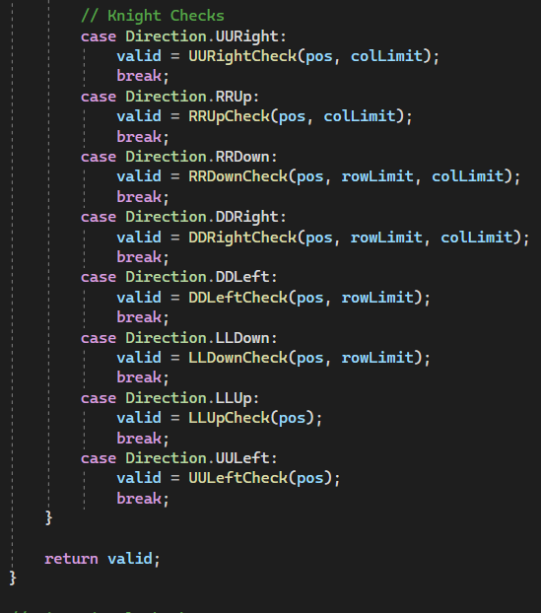
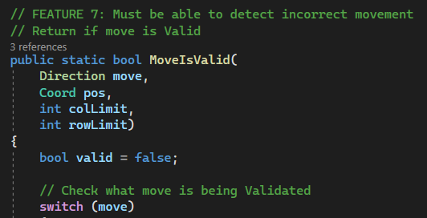
7.1 Must be able to detect incorrect movement
Returns True if the move is within bounds of the Level’s Board.

Slide 18
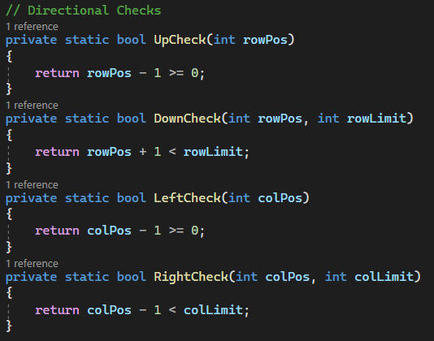
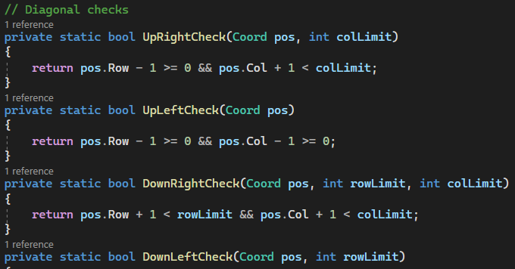
7.2 Must be able to detect incorrect movement
Check functions for each Directional Check

Slide 19
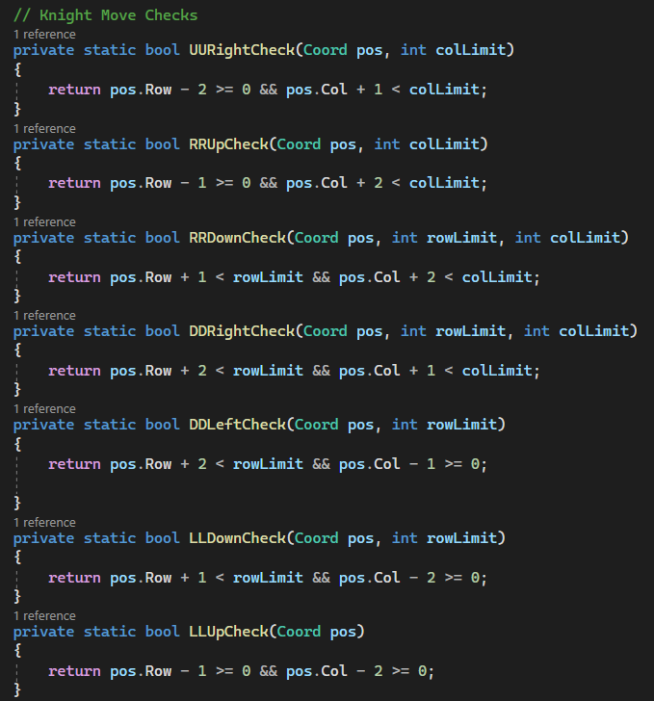
7.3 Must be able to detect incorrect movement
Check functions for Knight Movement

Slide 20
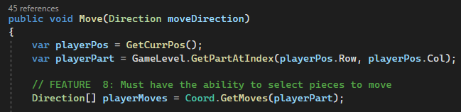
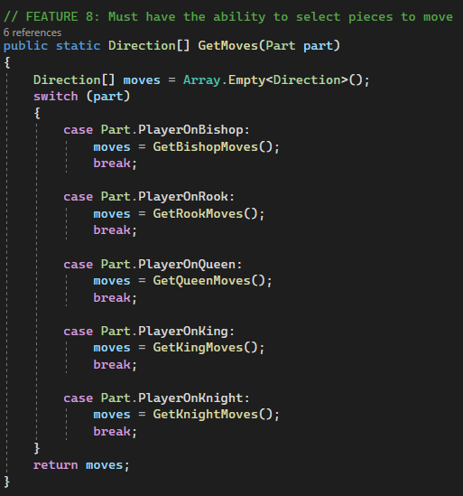
8. Must have the ability to select pieces to move
Grabs Move Set Based on the Chess Piece the Player is currently at.

Slide 21
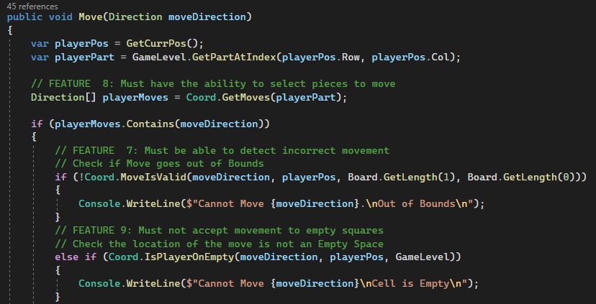
9. Must not accept movement to empty squares
Move Validation: Player Must not be able to move into an Empty Square space

Slide 22
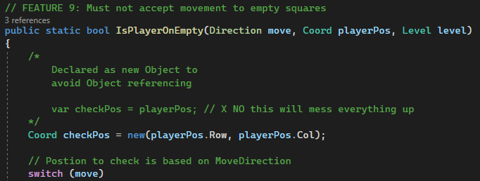
9.1 Must not accept movement to empty squares
Initialize a new Coord Object as a position checker to determine if the Square is Empty.

Slide 23
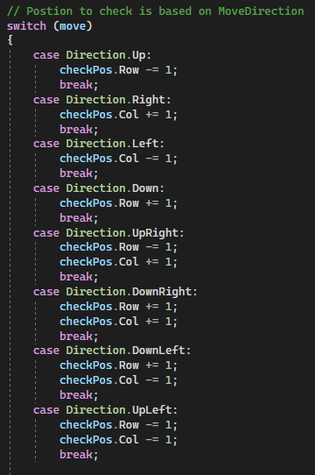
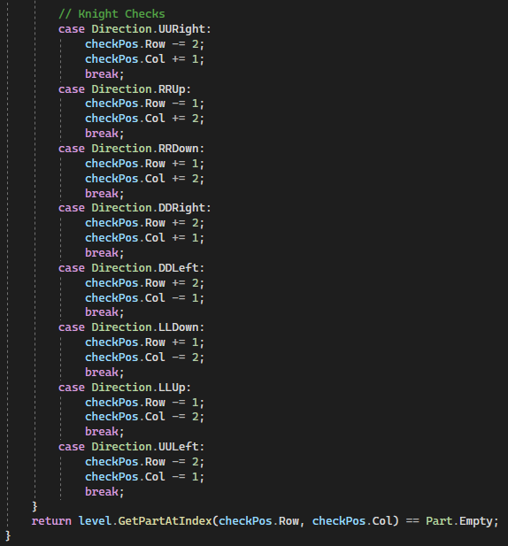
9.1 Must not accept movement to empty squares
Apply Move Direction to Position Checker
Returns true if the “moved” position is an Empty Square

Slide 24
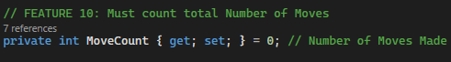
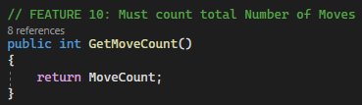
10. Must count total number of moves
Game Property: MoveCount, counts number of moves made.

Slide 25
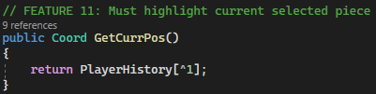
11. Must highlight current selected piece
Returns Player’s Current position in the board

Slide 26
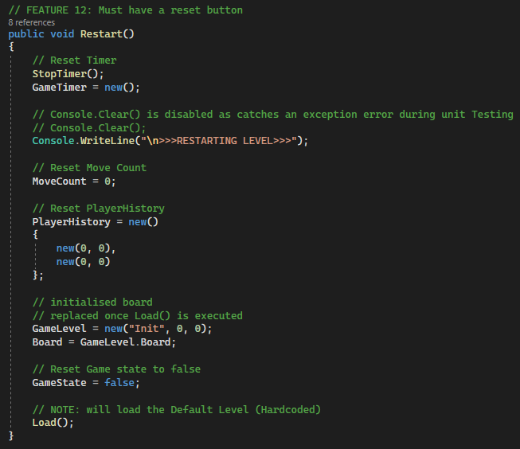
12. Must have a reset button
Restarts the game.
Note: Load has a default string input. The feature will not reload Custom Inputs.

Slide 27
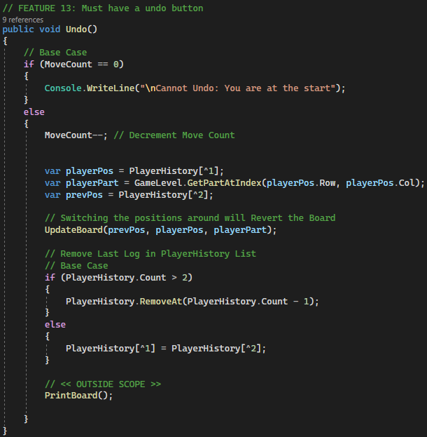
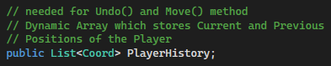
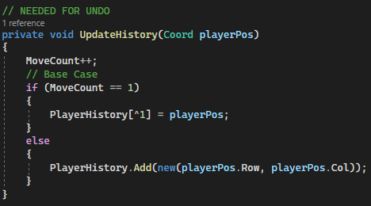
13. Must have an undo button
Undo Last Move made
Game Property

Slide 28
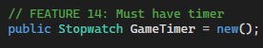
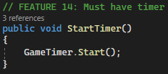
14. Must have a timer
Game Property: GameTimer
In-game Timer triggered when the game is Loaded.

Slide 29
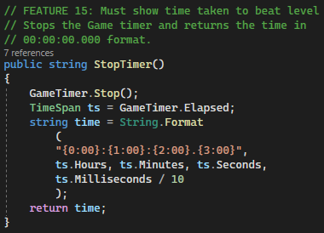
15. Must show time taken to beat level
Returns Game Timer in String Format

Slide 30
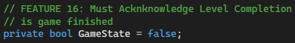
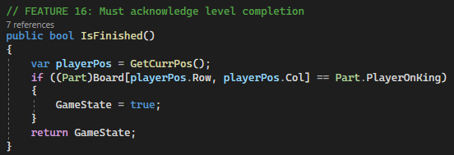
16. Must acknowledge level completion
Game Property: GameState

Slide 31
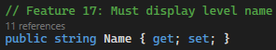
17. Must display level name
Level Property: Name

Slide 32
Testing

Slide 33
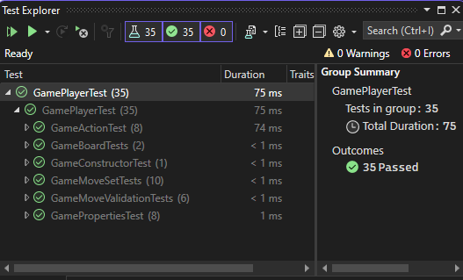
All Tests (Contents)

Slide 34
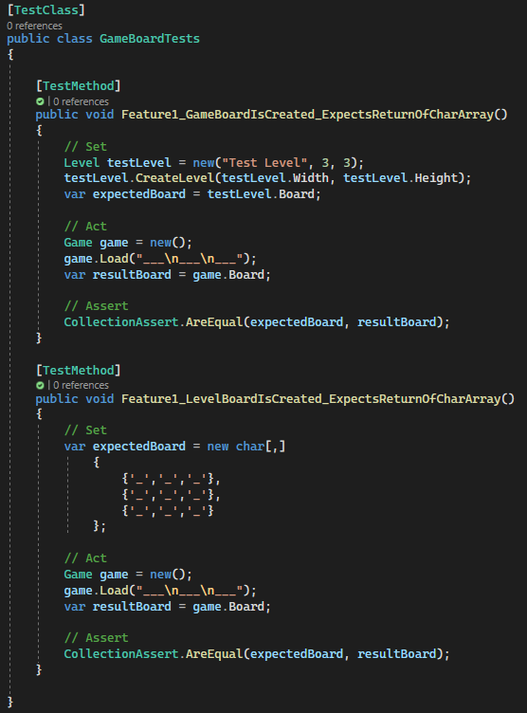
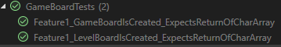
GameBoardTests
Tests:
1. Must have a game board with correct co-ordinates

Slide 35
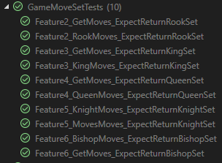
GameMoveSetTests
Tests:
2. Must have movement for Rook
3. Must have movement for King
4. Must have movement for Queen
5. Must have movement for Knight
6. Must have movement for Bishop

Slide 36
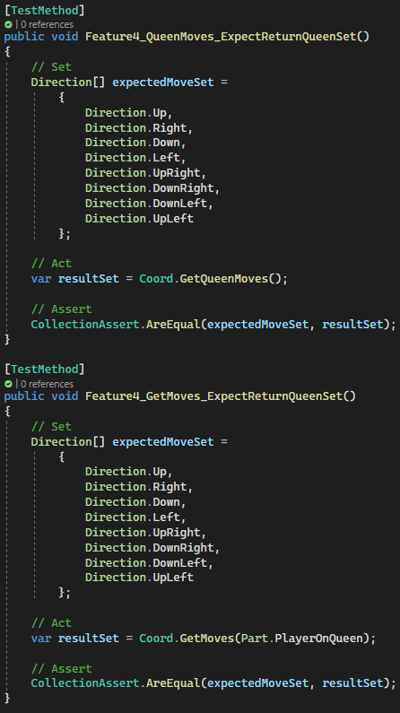
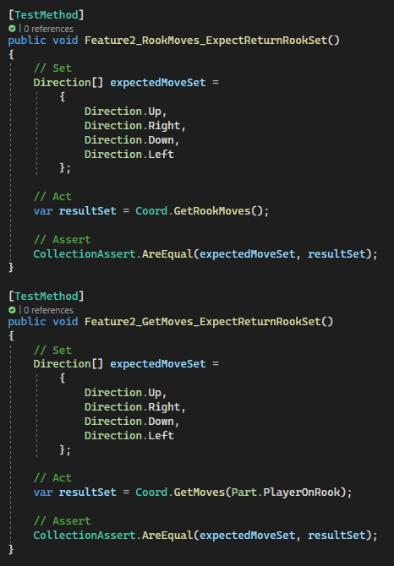
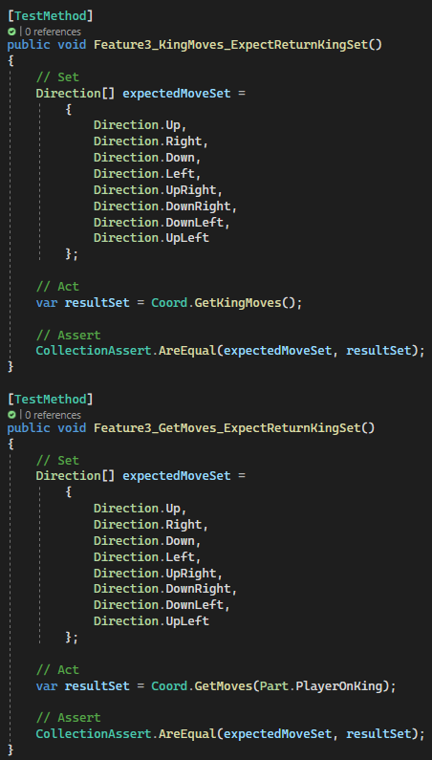
GameMoveSetTests

Slide 37
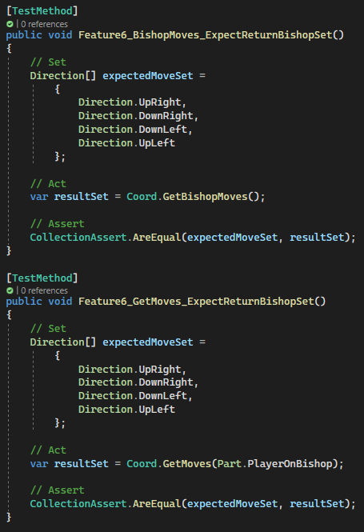
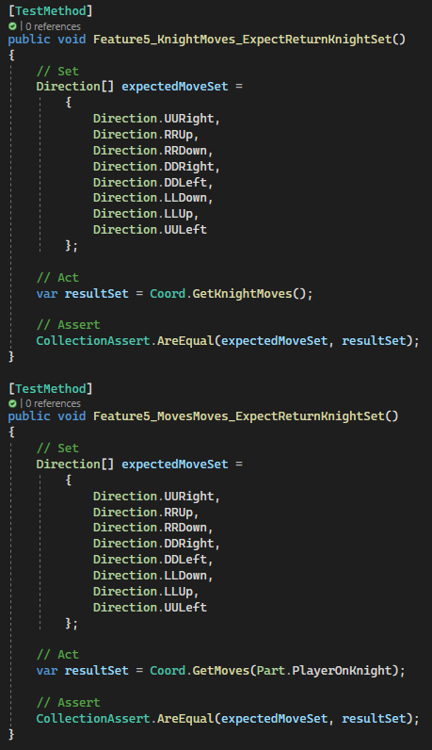
GameMoveSetTests

Slide 38
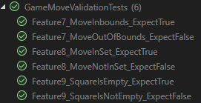
GameMoveValidatonTests
Tests:
7. Must be able to detect incorrect movement
8. Must have the ability to select pieces to move
9. Must not accept movement to empty squares

Slide 39
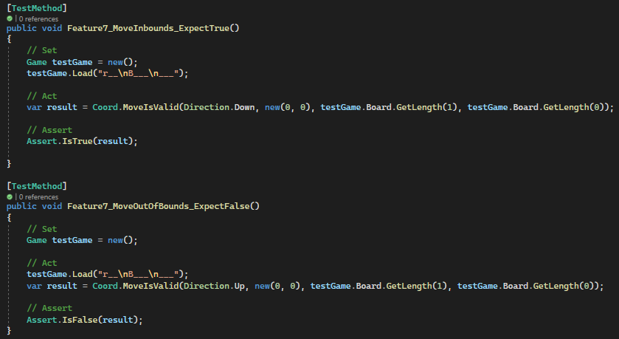
GameMoveValidatonTests

Slide 40
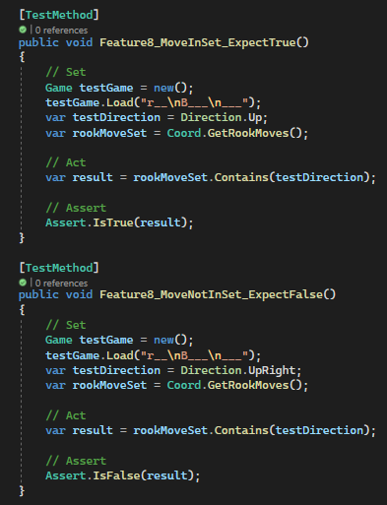
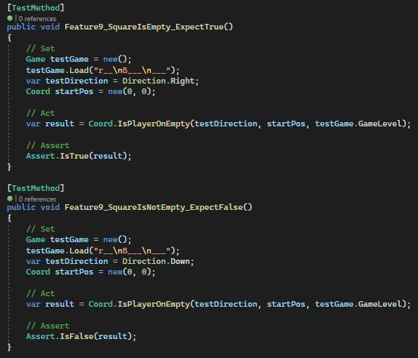
GameMoveValidatonTests

Slide 41

GamePropertiesTests
Tests:
10. Must count total number of moves
11. Must highlight current selected piece
14. Must have a timer
17. Must display level name

Slide 42


GamePropertiesTests

Slide 43


GamePropertiesTests

Slide 44

GamePropertiesTests
Tests:
12. Must have a reset button
13. Must have an undo button
15. Must show time taken to beat level
16. Must acknowledge level completion

Slide 45


GamePropertiesTests

Slide 46

GamePropertiesTests

Slide 47

GamePropertiesTests

Slide 48


GamePropertiesTests

Slide 49


GameConstructorTest
Tests:
Class Game() Constructor

